Slide 1


Online Hackathon 2018
Team Name:- SMART BABU
Gujarat

Slide 2

Team Details
Project Name
SU-Swagatam
Team member Name
Kaushal Jani
Harsh Mangukiya
Swarnim Varshney

Slide 3
List of Modules
1) “Hamrahi”- Voice base Tour Guide
(using artificial intelligence)
2) Chat-bot – your pocket robot for all information( using neural network)
3)”Raju”- GPS-based local guide finder
(using GPS service)
4) “Aalekh” – QR code base information
5) “WE care”- tourist Tracking and emergency system
6) “E-Bazar”- online shopping for Local famous items
7) “Anand”- local hotel, food, events, festival and much more…

Slide 4
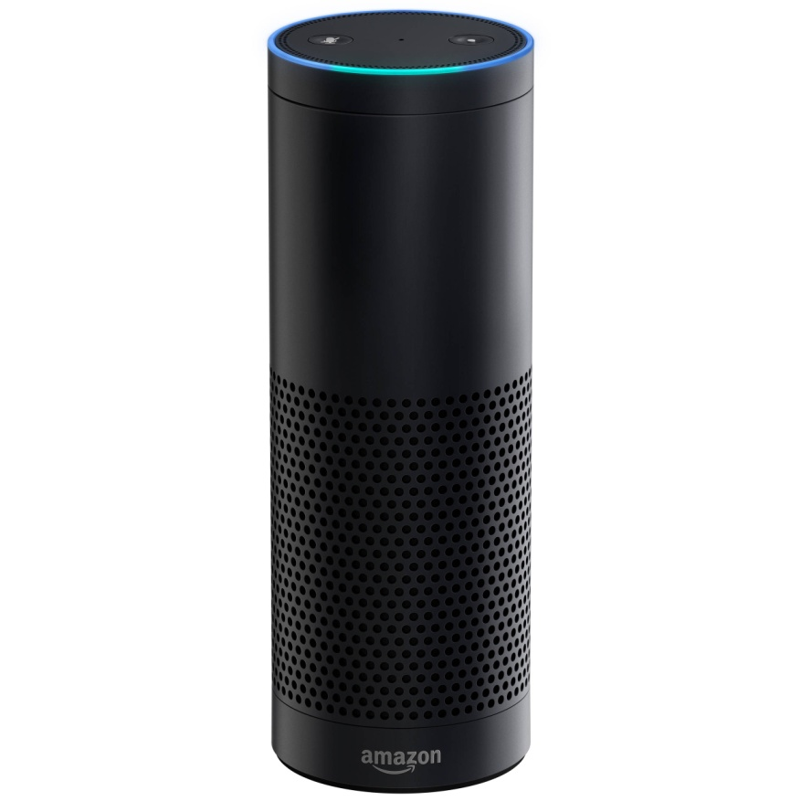
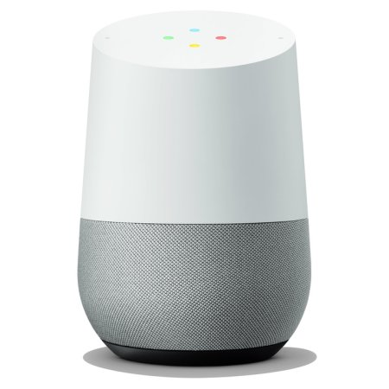
“Hamrahi”- Voice base Tour Guide (using artificial intelligence)
Talk and know details in multi-languages like English, Hindi, French and many more… using google home and amazon alexa

Slide 5
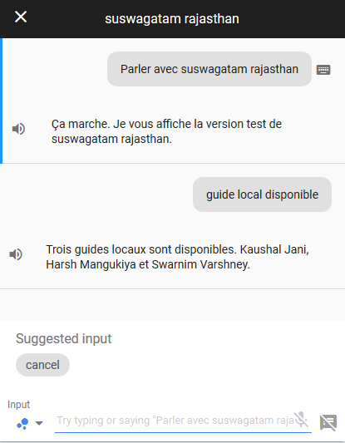
Chat-bot – your pocket robot for all information( using neural network)
User can chat in multiple language using this chatbot.
Ask questions like

Slide 6
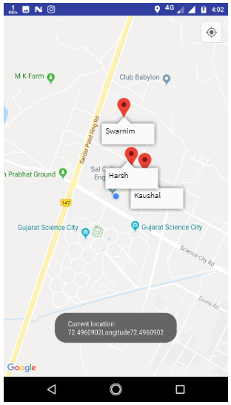
”Raju”- GPS-based local guide finder (using GPS service)
This service will find nearest government authorized guide near to tourist location as per their location.

Slide 7
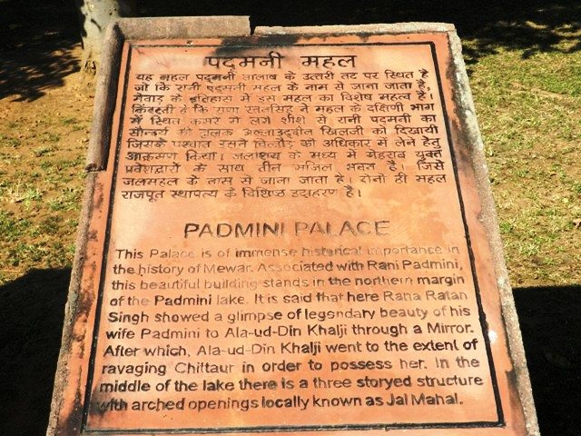

“Aalekh” – QR code base information
This service will give particular spot information using qr code.
QR code will be placed at every point of the tourist place.

Slide 8

“WE care”- tourist Tracking and emergency system
This service is used to track the person in case of emergency.
Tourist can enable this tracking service using their mobile app
If there is any medical emergency occurs or tourist is messing, this service can be much helpful to get his/her last location

Slide 9
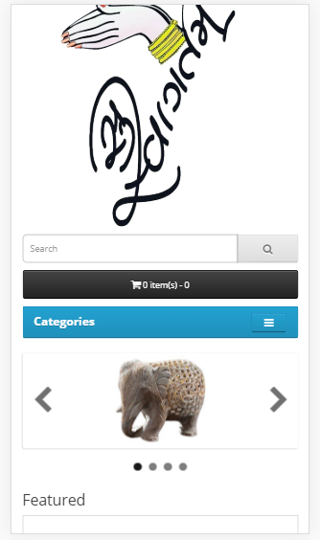
“E-Bazar”- online shopping for Local famous items
E-Bazar is online shopping market for purchasing the famous local item at just one click
It helps user to buy items from anywhere to anywhere. User doesn’t need to go there and buy it.

Slide 10
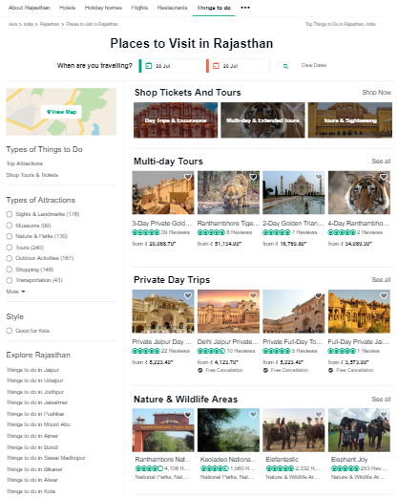
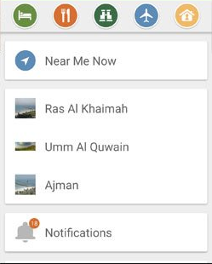
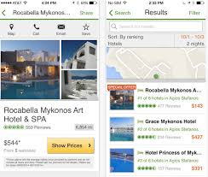
“Anand”- local hotel, food, events, festival and much more…
Tourist can find local hotel, food, upcoming events and local festival from the application

Slide 11

Thank you

